Slide 1




Session 5 B:The role of decentralized production in promoting energy security, access to
energy, and consumer empowerment
Illegal Microgrids in Lebanon: From Informal Diesel Supply to a Regulated Path
Dr. Sorina Mortada
Lebanon Electricity Regulatory Authority
Sorina.mortada@gmail.com
WFER IX | 24 September 2026

Slide 2
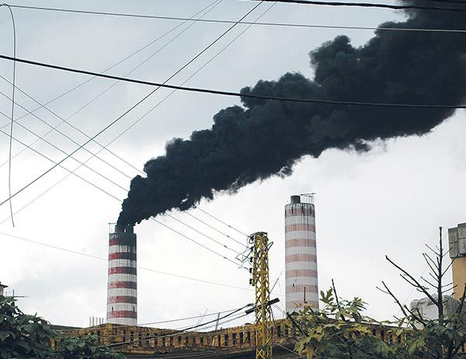
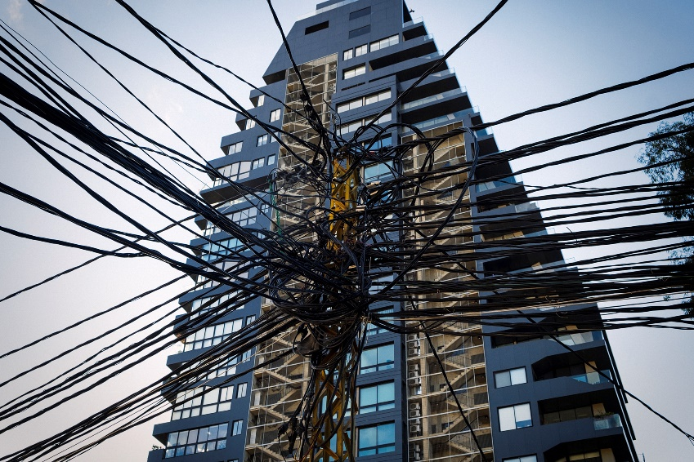
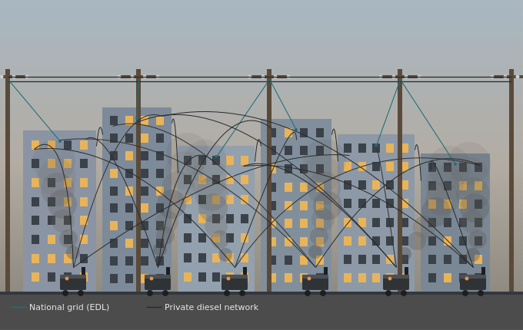
Current Status-Electricity Sector
Significant tariff subsidies with a highly burden on the national budget until 2021
Significant gap between electricity demand and supply.
Gap is covered by self-generation:
  Private individual diesel generators (legal if power less than 1.5 MW and if Ministry of Environment’s minimum environmental standards are complied with.
  Neighborhood-level diesel generators (informal).
Distribution of neighborhood-level generated electricity is done through informal networks (not connected to the national grid).
Source: https://magazine.com.lb/
Source: https://www.bytheeast.com/
Source: AI Generated

Slide 3
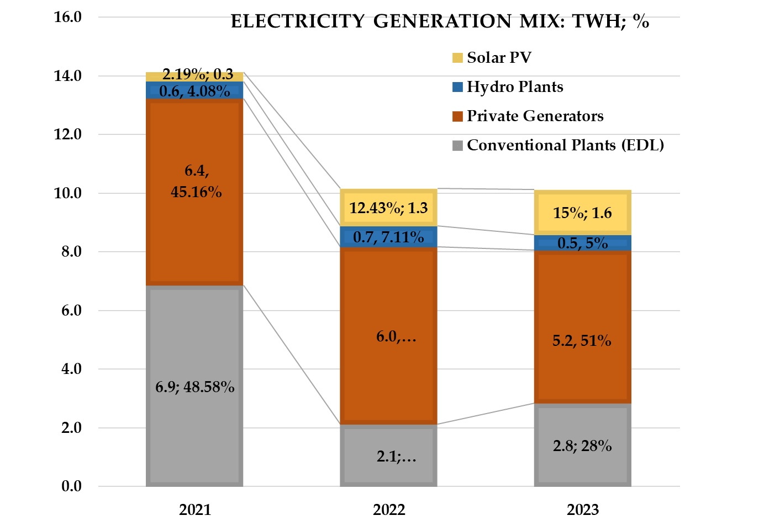
Lebanon’s electricity sector
Electricity Generation Mix (TWh; %)
Four main factors contributed to the 29% reduction in electricity consumption:
Diesel subsidy removal implemented in October 2021
EDL tariff reform enacted in November 2022
Consumption behavioral change due to income constraints
Compounded effect of the financial crisis
The overall contribution of renewable energy has grown, which suggests a transition toward alternative energy sources. This shift is in response to the rising cost of diesel and the removal of subsidies.
Source: The 2023 Solar PV Status Report for Lebanon-LCEC

Slide 4
Current Sector Structure
A legacy vertically-integrated model, with a large unregulated parallel market.
Ministry of Energy and Water
Policy, planning, fuel procurement, tariff approval
Électricité du Liban (EDL)
Vertically integrated public monopoly
Generation
Thermal & hydro
Aging, fuel-dependent
~8–10 hrs/day
Transmission
High-voltage grid
National Control Centre
Aging, war-damaged
Distribution and supply
Single national distributor
Collection ~60%
Losses ~40%
Private diesel generators
Unregulated, parallel supply — c. ⅔ of demand
Concessions
Decentralized solar ~1,500 MW installed, mostly behind-the-meter
This structure is incompatible with the unbundling principles of Law 462/2002 and cannot deliver cost-reflective, resilient service.

Slide 5
Where the Sector Stands Today
EDL operates as a vertically integrated public monopoly controlling over 90% of generation and distribution assets — structurally unable to deliver reliable, cost-reflective service.
8–10 hrs/day
~40%
~60%
Supply delivered, vs. demand nearly 3x that level
Technical & non-technical losses of total throughput
Collection rate on billed electricity
~2/3
~7,500
~1,500 MW
Of national demand met by unregulated private diesel generators
Local diesel generator operators filling the supply gap
Behind-the-meter solar capacity installed to date
In practice, neighborhood diesel subscriptions are Lebanon’s de facto microgrids — unlicensed and unregulated

Slide 6
Law 462/2002: The Sector Planning Model
The blueprint for an unbundled, competitive electricity sector
Establishes the Electricity Regulatory Authority (ERA) and the legal basis for sector unbundling
Sets the guiding principles: least-cost planning, operational efficiency, financial sustainability, regulatory independence
Phase 1: EDL is corporatized into Public SAL, a single transitional electricity company
Phase 2: Public SAL's assets are split into independent GENCOs, the Single Buyer, TRANSCO and regional DSOs
GENCOs / IPPs / Imports
Generation
Single Buyer
Sole wholesale offtaker
TRANSCO
Independent transmission operator
Regional DSOs
Distribution & supply

Slide 7
Law 318/2023: Distributed Renewable Energy
The legal basis for prosumers, captive generation, P2P and microgrids
Gives legal standing to distributed generation, prosumers, net metering, peer-to-peer trading and microgrids
Establishes a tiered, capacity-based regime so oversight scales with project size
Complements Law 462/2002: DRE resources support security of supply and renewable deployment without waiting for grid extension
Together with the Policy Note, positions microgrids as a regulated bridge; not a permanent parallel system

Slide 8
Demand-Side Participation & Decentralised Supply
Renewable and distributed resources are a fundamental pillar of both the transitional and long-term market — complementing, not replacing, investment in utility-scale infrastructure.
TIERED REGIME FOR DISTRIBUTED GENERATION
< 1.5 MW
1.5 – 10 MW
> 10 MW
Registration only
ERA authorization / permit
Full utility-scale licensing
Microgrids
Captive Generation
Prosumers, P2P & Net Metering
Subject to ERA non-objection decision; permitted where the relevant DSO cannot deliver adequate service within a reasonable timeframe. Clean generation must dominate the supply mix; must integrate with the DSO network once it extends to the area.
Projects up to 10 MW under ERA authorization- self-supply (including multi-site via regulated wheeling), ancillary services, and regulated sale of surplus.
Net metering, peer-to-peer trading, demand response and energy efficiency complement the transitional market and accelerate NREAP renewable targets.

Slide 9

Microgrids: Conditions for ERA’s Interim Non-Objection Decision
Microgrids are not licensed like DSOs — they proceed on an ERA “non-objection decision” (NOD), granted only where objective criteria show a microgrid is the most appropriate solution.
1
DSO Service Gap
2
Objective Justification
3
Clean-Generation Dominance
Available only where the relevant DSO is unable to provide adequate availability and quality of service within a reasonable timeframe
ERA issues the NOD where technical, economic and public-interest criteria show the microgrid best improves reliability, resilience, electrification, or least-cost supply.
Microgrids must be designed and operated with clean generation as the dominant supply source, supported by storage and other technologies for reliability.
4
No Parallel Networks
5
Open, Qualified Operators
6
Location- & Time-Bound
Parallel territorial networks are prohibited unless the DSO network is unavailable or technically infeasible; coordination with the DSO is required throughout.
Open to municipalities, cooperatives and private developers meeting ERA's objective eligibility and technical criteria where no exclusivity for any operator class.
A non-objection decision may be location-specific and time-bound, and does not prejudice future expansion of the public distribution network.
Upon extension: once the DSO's distribution network reaches the microgrid's service area, the microgrid must integrate with the DSO under the regulatory framework . This integration creates no obligation for Government or ERA. ERA also sets interconnection rights, standby/exit charges, and safeguards for DSO financial viability.

Slide 10
Microgrid NOD Framework
ERA's interim rulebook for approving microgrid projects
  Sets the eligibility criteria, application process and conditions for ERA's Non-Objection Decision (NOD) — the interim route to legalize a microgrid pending full DRE licensing rules
  Applicants must pass 8 cumulative tests: public interest, service adequacy, technical suitability, economic efficiency, renewable energy, network compatibility, consumer protection and future integration
  Capped at 10 MW; renewables must dominate the supply mix; parallel networks barred unless the DSO genuinely cannot serve the area
  USD 4,000 application fee; NOD is location- and time-bound, non-transferable, and must integrate with the DSO once its network is extended — with no compensation
STATUS: OUT FOR CONSULTATION
Version 1.0 (29 July 2026) is currently being tested through a stakeholder consultation process

Slide 11
Thank You
Questions & Discussion

